Slide 1
VLANs

Slide 2
Overview of VLANs

Slide 3
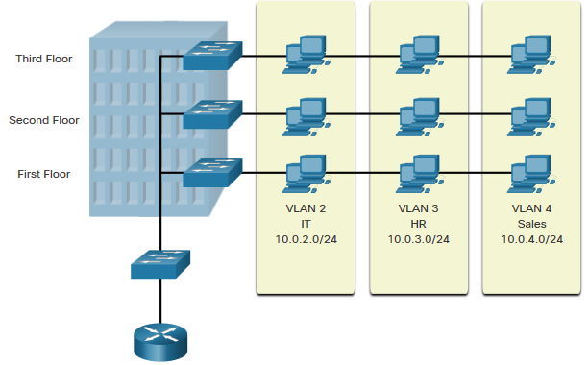
Overview of VLANs VLAN Definitions
VLANs are logical connections with other similar devices.
Placing devices into various VLANs have the following characteristics:
Provides segmentation of the various groups of devices on the same switches
Provide organization that is more manageable
Broadcasts, multicasts and unicasts are isolated in the individual VLAN
Each VLAN will have its own unique range of IP addressing
Smaller broadcast domains

Slide 4
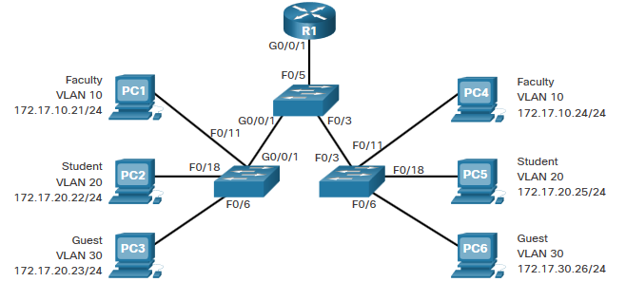
Overview of VLANs Benefits of a VLAN Design
Benefits of using VLANs are as follows:
Benefits | Description
Smaller Broadcast Domains | Dividing the LAN reduces the number of broadcast domains
Improved Security | Only users in the same VLAN can communicate together
Improved IT Efficiency | VLANs can group devices with similar requirements, e.g. faculty vs. students
Reduced Cost | One switch can support multiple groups or VLANs
Better Performance | Small broadcast domains reduce traffic, improving bandwidth
Simpler Management | Similar groups will need similar applications and other network resources

Slide 5
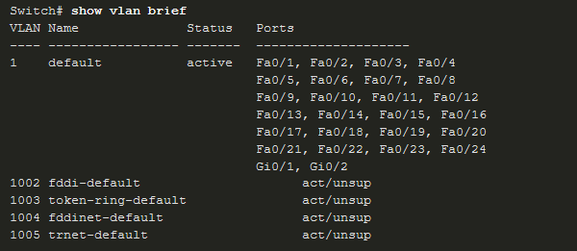
Overview of VLANs Types of VLANs
Default VLAN
VLAN 1 is the following:
The default VLAN
The default Native VLAN
The default Management VLAN
Cannot be deleted or renamed
Note: While we cannot delete VLAN1 Cisco will recommend that we assign these default features to other VLANs

Slide 6
Overview of VLANs Types of VLANs (Cont.)
Data VLAN
Dedicated to user-generated traffic (email and web traffic).
VLAN 1 is the default data VLAN because all interfaces are assigned to this VLAN.
Native VLAN
This is used for trunk links only.
All frames are tagged on an 802.1Q trunk link except for those on the native VLAN.
Management VLAN
This is used for SSH/Telnet VTY traffic and should not be carried with end user traffic.
Typically, the VLAN that is the SVI for the Layer 2 switch.

Slide 7
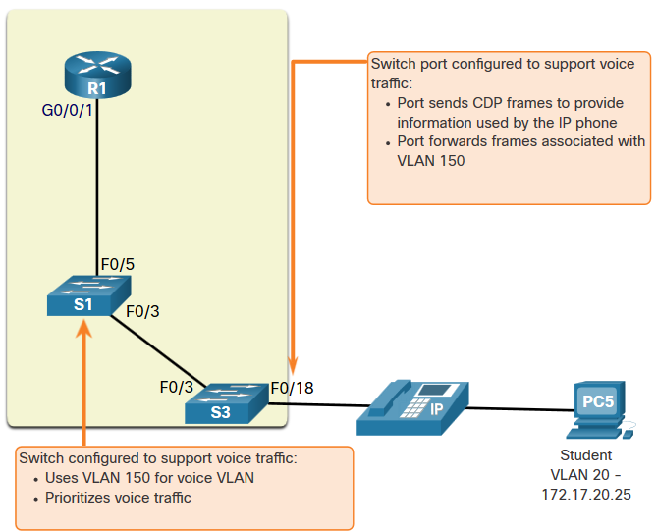
Overview of VLANs Types of VLANs (Cont.)
Voice VLAN
A separate VLAN is required because Voice traffic requires:
Assured bandwidth
High QoS priority
Ability to avoid congestion
Delay less that 150 ms from source to destination
The entire network must be designed to support voice.

Slide 8
VLANs in a Multi-Switched Environment

Slide 9
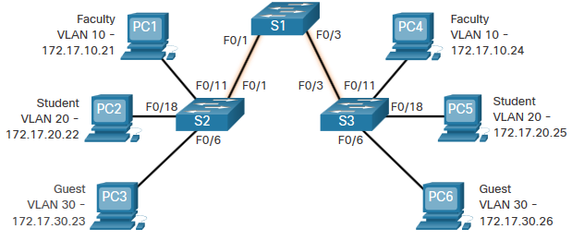
VLANs in a Multi-Switched Environment Defining VLAN Trunks
A trunk is a point-to-point link between two network devices.
Cisco trunk functions:
Allow more than one VLAN
Extend the VLAN across the entire network
By default, supports all VLANs
Supports 802.1Q trunking

Slide 10
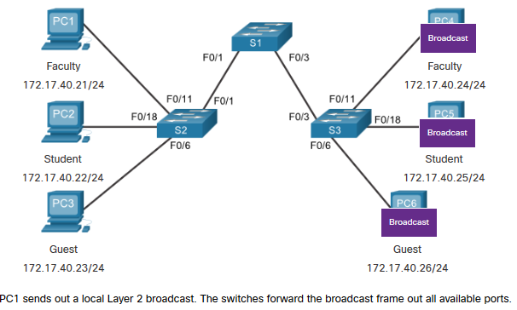
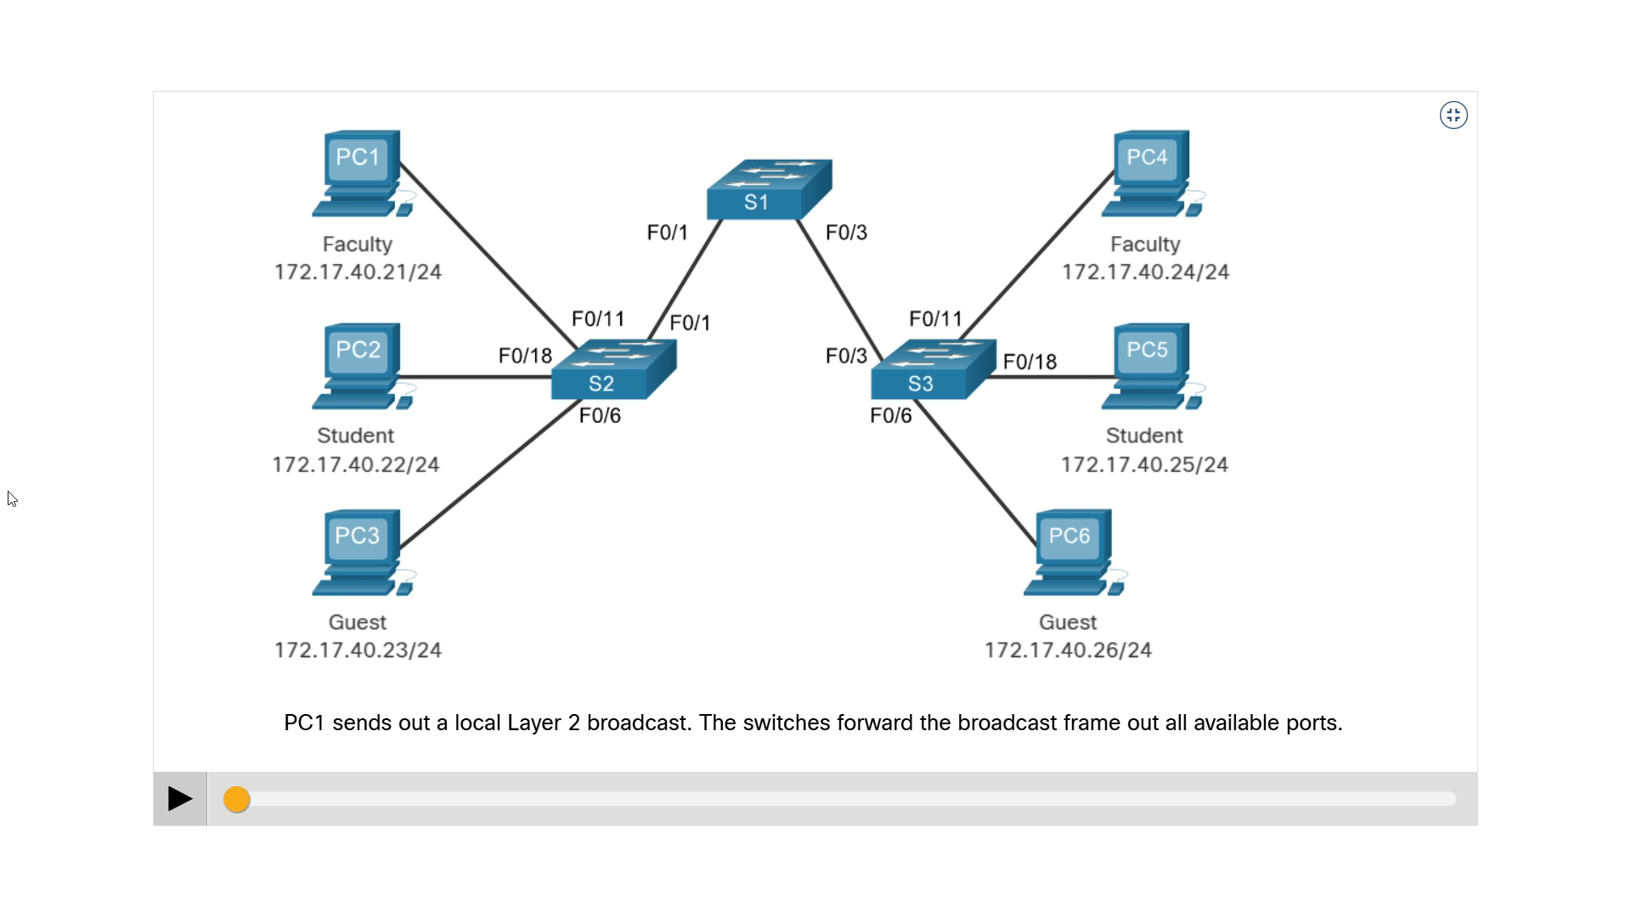
VLANs in a Multi-Switched Environment Networks without VLANs
Without VLANs, all devices connected to the switches will receive all unicast, multicast, and broadcast traffic.

Slide 11
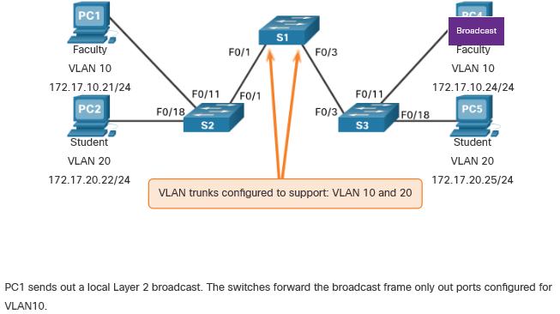
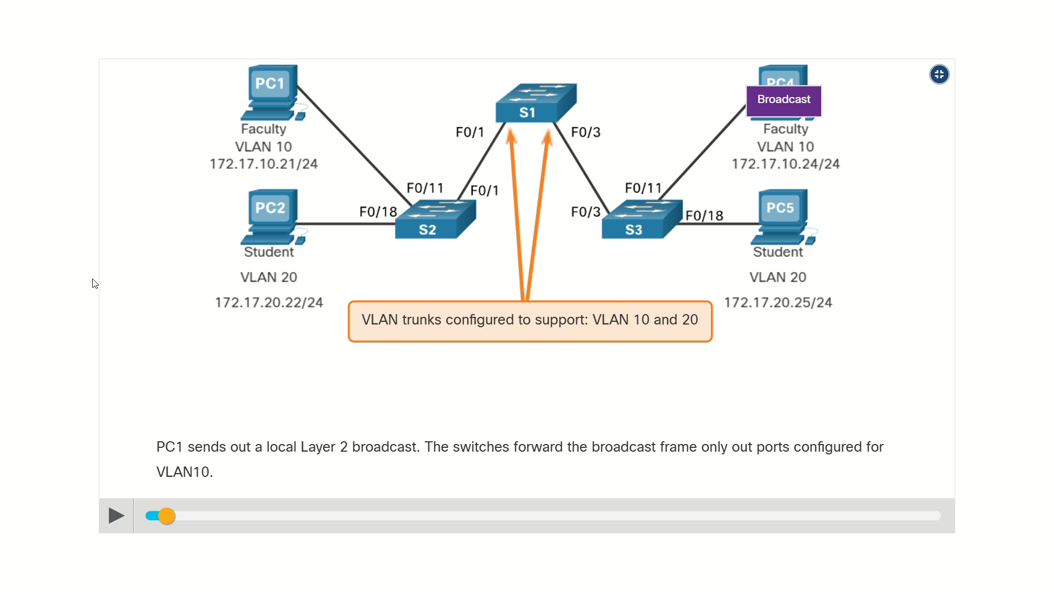
VLANs in a Multi-Switched Environment Networks with VLANs
With VLANs, unicast, multicast, and broadcast traffic is confined to a VLAN. Without a Layer 3 device to connect the VLANs, devices in different VLANs cannot communicate.

Slide 12
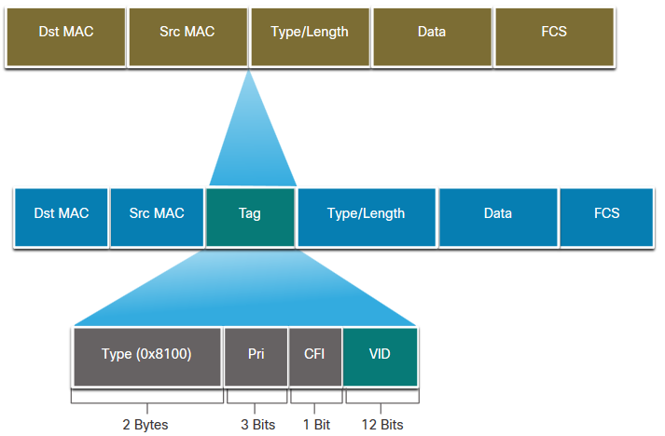
VLANs in a Multi-Switched Environment VLAN Identification with a Tag
The IEEE 802.1Q header is 4 Bytes
When the tag is created the FCS must be recalculated.
When sent to end devices, this tag must be removed and the FCS recalculated back to its original number.
802.1Q VLAN Tag Field | Function
Type | 2-Byte field with hexadecimal 0x8100 This is referred to as Tag Protocol ID (TPID)
User Priority | 3-bit value that supports
Canonical Format Identifier (CFI) | 1-bit value that can support token ring frames on Ethernet
VLAN ID (VID) | 12-bit VLAN identifier that can support up to 4096 VLANs

Slide 13
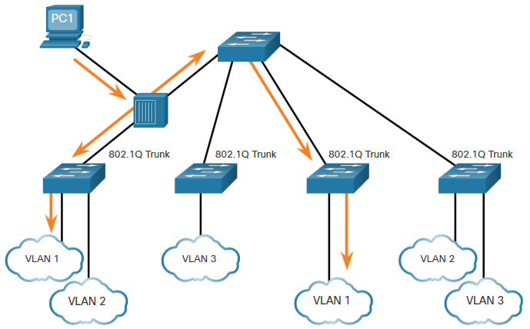
VLANs in a Multi-Switched Environment Native VLANs and 802.1Q Tagging
802.1Q trunk basics:
Tagging is typically done on all VLANs.
The use of a native VLAN was designed for legacy use, like the hub in the example.
Unless changed, VLAN1 is the native VLAN.
Both ends of a trunk link must be configured with the same native VLAN.
Each trunk is configured separately, so it is possible to have a different native VLANs on separate trunks.

Slide 14
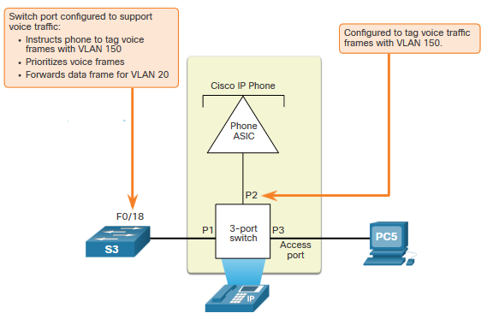
VLANs in a Multi-Switched Environment Voice VLAN Tagging
The VoIP phone is a three port switch:
The switch will use CDP to inform the phone of the Voice VLAN.
The phone will tag its own traffic (Voice) and can set Cost of Service (CoS). CoS is QoS for layer 2.
The phone may or may not tag frames from the PC.
Traffic | Tagging Function
Voice VLAN | tagged with an appropriate Layer 2 class of service (CoS) priority value
Access VLAN | can also be tagged with a Layer 2 CoS priority value
Access VLAN | is not tagged (no Layer 2 CoS priority value)

Slide 15
VLAN Configuration

Slide 16
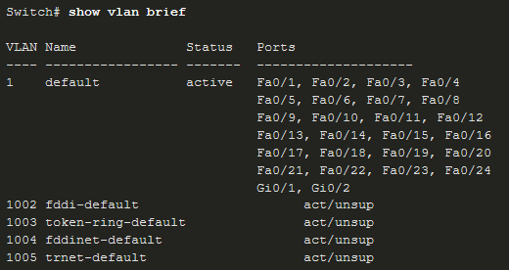
VLAN Configuration VLAN Ranges on Catalyst Switches
Catalyst switches 2960 and 3650 support over 4000 VLANs.
Normal Range VLAN 1 – 1005 | Extended Range VLAN 1006 - 4095
Used in Small to Medium sized businesses | Used by Service Providers
1002 – 1005 are reserved for legacy VLANs | Are in Running-Config
1, 1002 – 1005 are auto created and cannot be deleted | Supports fewer VLAN features
Stored in the vlan.dat file in flash | Requires VTP configurations
VTP can synchronize between switches

Slide 17
VLAN Configuration VLAN Creation Commands
VLAN details are stored in the vlan.dat file. You create VLANs in the global configuration mode.
Task | IOS Command
Enter global configuration mode. | Switch# configure terminal
Create a VLAN with a valid ID number. | Switch(config)# vlan vlan-id
Specify a unique name to identify the VLAN. | Switch(config-vlan)# name vlan-name
Return to the privileged EXEC mode. | Switch(config-vlan)# end
Enter global configuration mode. | Switch# configure terminal

Slide 18
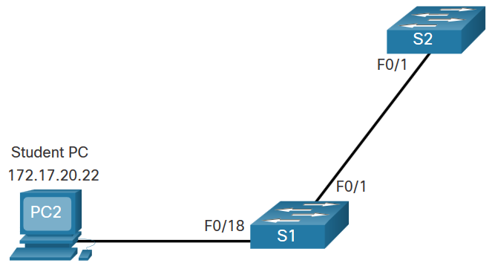
VLAN Configuration VLAN Creation Example
If the Student PC is going to be in VLAN 20, we will create the VLAN first and then name it.
If you do not name it, the Cisco IOS will give it a default name of vlan and the four digit number of the VLAN. E.g. vlan0020 for VLAN 20.
Prompt | Command
S1# | Configure terminal
S1(config)# | vlan 20
S1(config-vlan)# | name student
S1(config-vlan)# | end

Slide 19
VLAN Configuration VLAN Port Assignment Commands
Once the VLAN is created, we can then assign it to the correct interfaces.
Task | Command
Enter global configuration mode. | Switch# configure terminal
Enter interface configuration mode. | Switch(config)# interface interface-id
Set the port to access mode. | Switch(config-if)# switchport mode access
Assign the port to a VLAN. | Switch(config-if)# switchport access vlan vlan-id
Return to the privileged EXEC mode. | Switch(config-if)# end

Slide 20
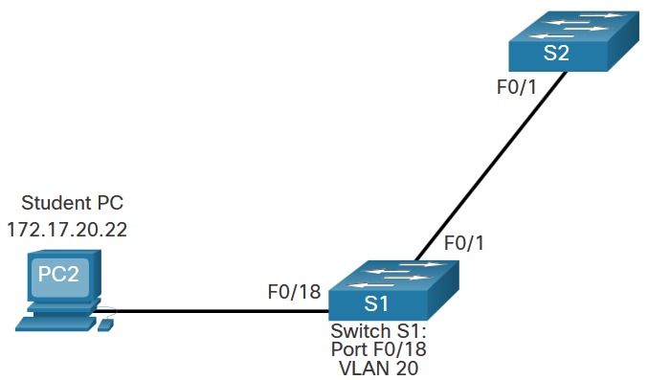
VLAN Configuration VLAN Port Assignment Example
We can assign the VLAN to the port interface.
Once the device is assigned the VLAN, then the end device will need the IP address information for that VLAN
Here, Student PC receives 172.17.20.22
Prompt | Command
S1# | Configure terminal
S1(config)# | Interface fa0/18
S1(config-if)# | Switchport mode access
S1(config-if)# | Switchport access vlan 20
S1(config-if)# | end

Slide 21
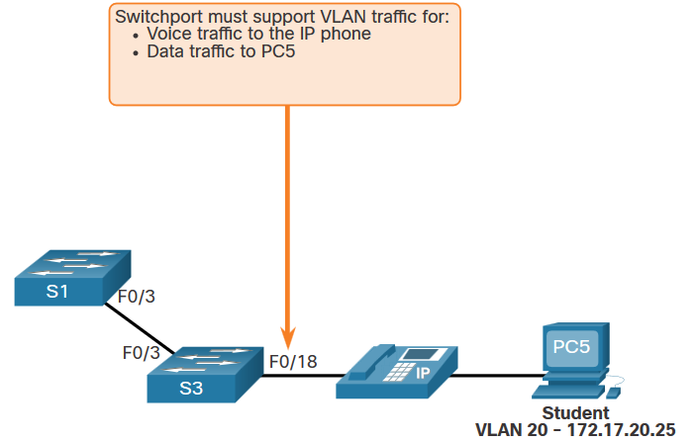
VLAN Configuration Data and Voice VLANs
An access port may only be assigned to one data VLAN. However it may also be assigned to one Voice VLAN for when a phone and an end device are off of the same switchport.

Slide 22
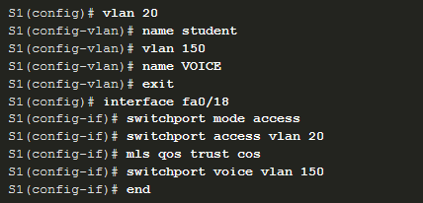
VLAN Configuration Data and Voice VLAN Example
We will want to create and name both Voice and Data VLANs.
In addition to assigning the data VLAN, we will also assign the Voice VLAN and turn on QoS for the voice traffic to the interface.
The newer catalyst switch will automatically create the VLAN, if it does not already exist, when it is assigned to an interface.
Note: QoS is beyond the scope of this course. Here we do show the use of the mls qos trust [cos | device cisco-phone | dscp | ip-precedence] command.

Slide 23
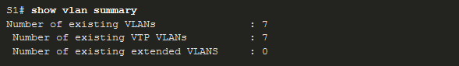
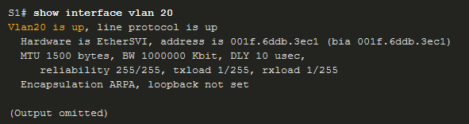
VLAN Configuration Verify VLAN Information
Use the show vlan command. The complete syntax is:
show vlan [brief | id vlan-id | name vlan-name | summary]
Task | Command Option
Display VLAN name, status, and its ports one VLAN per line. | brief
Display information about the identified VLAN ID number. | id vlan-id
Display information about the identified VLAN name. The vlan-name is an ASCII string from 1 to 32 characters. | name vlan-name
Display VLAN summary information. | summary

Slide 24
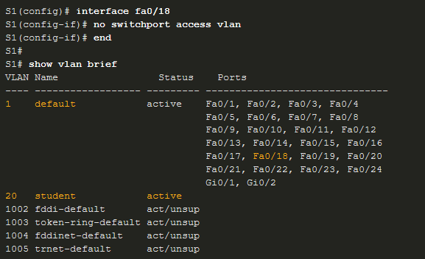
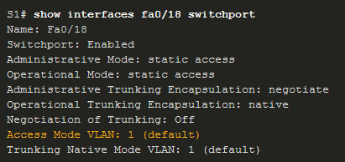
VLAN Configuration Change VLAN Port Membership
There are a number of ways to change VLAN membership:
re-enter switchport access vlan vlan-id command
use the no switchport access vlan to place interface back in VLAN 1
Use the show vlan brief or the show interface fa0/18 switchport commands to verify the correct VLAN association.

Slide 25
VLAN Configuration Delete VLANs
Delete VLANs with the no vlan vlan-id command.
Caution: Before deleting a VLAN, reassign all member ports to a different VLAN.
Delete all VLANs with the delete flash:vlan.dat or delete vlan.dat commands.
Reload the switch when deleting all VLANs.
Note: To restore to factory default – unplug all data cables, erase the startup-configuration and delete the vlan.dat file, then reload the device.

Slide 26
VLAN Trunks

Slide 27
VLAN Trunks Trunk Configuration Commands
Configure and verify VLAN trunks. Trunks are layer 2 and carry traffic for all VLANs.
Task | IOS Command
Enter global configuration mode. | Switch# configure terminal
Enter interface configuration mode. | Switch(config)# interface interface-id
Set the port to permanent trunking mode. | Switch(config-if)# switchport mode trunk
Sets the native VLAN to something other than VLAN 1. | Switch(config-if)# switchport trunk native vlan vlan-id
Specify the list of VLANs to be allowed on the trunk link. | Switch(config-if)# switchport trunk allowed vlan vlan-list
Return to the privileged EXEC mode. | Switch(config-if)# end

Slide 28
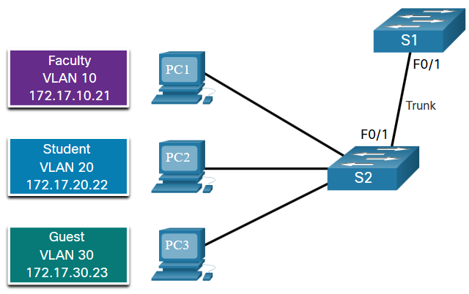
VLAN Trunks Trunk Configuration Example
The subnets associated with each VLAN are:
VLAN 10 - Faculty/Staff - 172.17.10.0/24
VLAN 20 - Students - 172.17.20.0/24
VLAN 30 - Guests - 172.17.30.0/24
VLAN 99 - Native - 172.17.99.0/24
F0/1 port on S1 is configured as a trunk port.
Note: This assumes a 2960 switch using 802.1q tagging. Layer 3 switches require the encapsulation to be configured before the trunk mode.
Prompt | Command
S1(config)# | Interface fa0/1
S1(config-if)# | Switchport mode trunk
S1(config-if)# | Switchport trunk native vlan 99
S1(config-if)# | Switchport trunk allowed vlan 10,20,30,99
S1(config-if)# | end

Slide 29
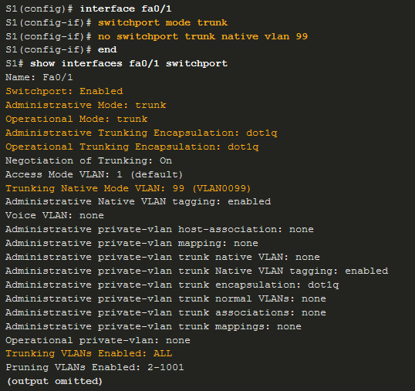
VLAN Trunks Verify Trunk Configuration
Set the trunk mode and native vlan.
Notice sh int fa0/1 switchport command:
Is set to trunk administratively
Is set as trunk operationally (functioning)
Encapsulation is dot1q
Native VLAN set to VLAN 99
All VLANs created on the switch will pass traffic on this trunk

Slide 30
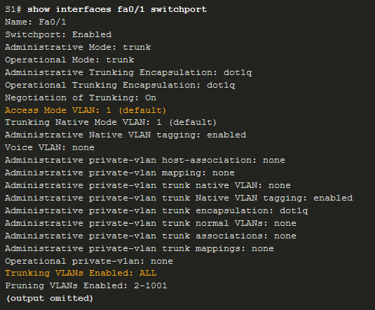
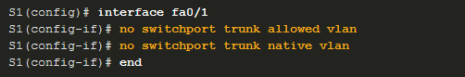
VLAN Trunks Reset the Trunk to the Default State
Reset the default trunk settings with the no command.
All VLANs allowed to pass traffic
Native VLAN = VLAN 1
Verify the default settings with a sh int fa0/1 switchport command.

Slide 31
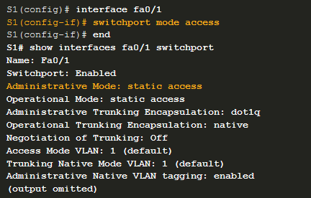
VLAN Trunks Reset the Trunk to the Default State (Cont.)
Reset the trunk to an access mode with the switchport mode access command:
Is set to an access interface administratively
Is set as an access interface operationally (functioning)

Slide 32
Dynamic Trunking Protocol

Slide 33
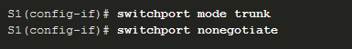
Dynamic Trunking Protocol Introduction to DTP
Dynamic Trunking Protocol (DTP) is a proprietary Cisco protocol.
DTP characteristics are as follows:
On by default on Catalyst 2960 and 2950 switches
Dynamic-auto is default on the 2960 and 2950 switches
May be turned off with the nonegotiate command
May be turned back on by setting the interface to dynamic-auto
Setting a switch to a static trunk or static access will avoid negotiation issues with the switchport mode trunk or the switchport mode access commands.

Slide 34
Dynamic Trunking Protocol Negotiated Interface Modes
The switchport mode command has additional options.
Use the switchport nonegotiate interface configuration command to stop DTP negotiation.
Option | Description
access | Permanent access mode and negotiates to convert the neighboring link into an access link
dynamic auto | Will becomes a trunk interface if the neighboring interface is set to trunk or desirable mode
dynamic desirable | Actively seeks to become a trunk by negotiating with other auto or desirable interfaces
trunk | Permanent trunking mode and negotiates to convert the neighboring link into a trunk link

Slide 35
Dynamic Trunking Protocol Results of a DTP Configuration
DTP configuration options are as follows:
 | Dynamic Auto | Dynamic Desirable | Trunk | Access
Dynamic Auto | Access | Trunk | Trunk | Access
Dynamic Desirable | Trunk | Trunk | Trunk | Access
Trunk | Trunk | Trunk | Trunk | Limited connectivity
Access | Access | Access | Limited connectivity | Access

Slide 36
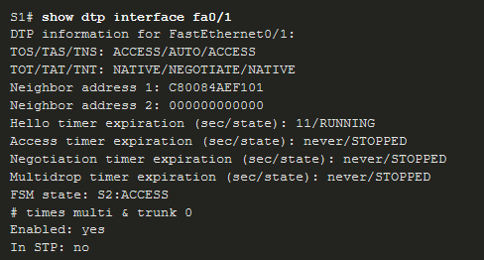
Dynamic Trunking Protocol Verify DTP Mode
The default DTP configuration is dependent on the Cisco IOS version and platform.
Use the show dtp interface command to determine the current DTP mode.
Best practice recommends that the interfaces be set to access or trunk and to turnoff DTP

Slide 37
Inter-VLAN Routing Operation

Slide 38
Inter-VLAN Routing Operation What is Inter-VLAN Routing?
VLANs are used to segment switched Layer 2 networks for a variety of reasons. Regardless of the reason, hosts in one VLAN cannot communicate with hosts in another VLAN unless there is a router or a Layer 3 switch to provide routing services.
Inter-VLAN routing is the process of forwarding network traffic from one VLAN to another VLAN.
There are three inter-VLAN routing options:
Legacy Inter-VLAN routing - This is a legacy solution. It does not scale well.
Router-on-a-Stick - This is an acceptable solution for a small to medium-sized network.
Layer 3 switch using switched virtual interfaces (SVIs) - This is the most scalable solution for medium to large organizations.

Slide 39
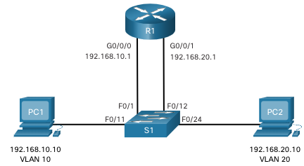
Inter-VLAN Routing Operation Legacy Inter-VLAN Routing
The first inter-VLAN routing solution relied on using a router with multiple Ethernet interfaces. Each router interface was connected to a switch port in different VLANs. The router interfaces served as the default gateways to the local hosts on the VLAN subnet.
Legacy inter-VLAN routing using physical interfaces works, but it has a significant limitation. It is not reasonably scalable because routers have a limited number of physical interfaces. Requiring one physical router interface per VLAN quickly exhausts the physical interface capacity of a router.
Note: This method of inter-VLAN routing is no longer implemented in switched networks and is included for explanation purposes only.

Slide 40
Inter-VLAN Routing Operation Router-on-a-Stick Inter-VLAN Routing
The ‘router-on-a-stick’ inter-VLAN routing method overcomes the limitation of the legacy inter-VLAN routing method. It only requires one physical Ethernet interface to route traffic between multiple VLANs on a network.
A Cisco IOS router Ethernet interface is configured as an 802.1Q trunk and connected to a trunk port on a Layer 2 switch. Specifically, the router interface is configured using subinterfaces to identify routable VLANs.
The configured subinterfaces are software-based virtual interfaces. Each is associated with a single physical Ethernet interface. Subinterfaces are configured in software on a router. Each subinterface is independently configured with an IP address and VLAN assignment. Subinterfaces are configured for different subnets that correspond to their VLAN assignment. This facilitates logical routing.
When VLAN-tagged traffic enters the router interface, it is forwarded to the VLAN subinterface. After a routing decision is made based on the destination IP network address, the router determines the exit interface for the traffic. If the exit interface is configured as an 802.1q subinterface, the data frames are VLAN-tagged with the new VLAN and sent back out the physical interface
Note: The router-on-a-stick method of inter-VLAN routing does not scale beyond 50 VLANs.

Slide 41
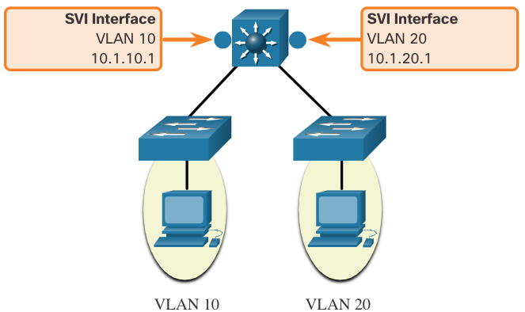
Inter-VLAN Routing Operation Inter-VLAN Routing on a Layer 3 Switch
The modern method of performing inter-VLAN routing is to use Layer 3 switches and switched virtual interfaces (SVI). An SVI is a virtual interface that is configured on a Layer 3 switch, as shown in the figure.
Note: A Layer 3 switch is also called a multilayer switch as it operates at Layer 2 and Layer 3. However, in this course we use the term Layer 3 switch.

Slide 42
Inter-VLAN Routing Operation Inter-VLAN Routing on a Layer 3 Switch (Cont.)
Inter-VLAN SVIs are created the same way that the management VLAN interface is configured. The SVI is created for a VLAN that exists on the switch. Although virtual, the SVI performs the same functions for the VLAN as a router interface would. Specifically, it provides Layer 3 processing for packets that are sent to or from all switch ports associated with that VLAN.
The following are advantages of using Layer 3 switches for inter-VLAN routing:
They are much faster than router-on-a-stick because everything is hardware switched and routed.
There is no need for external links from the switch to the router for routing.
They are not limited to one link because Layer 2 EtherChannels can be used as trunk links between the switches to increase bandwidth.
Latency is much lower because data does not need to leave the switch in order to be routed to a different network.
They more commonly deployed in a campus LAN than routers.
The only disadvantage is that Layer 3 switches are more expensive.

Slide 43
Router-on-a-Stick Inter-VLAN Routing

Slide 44
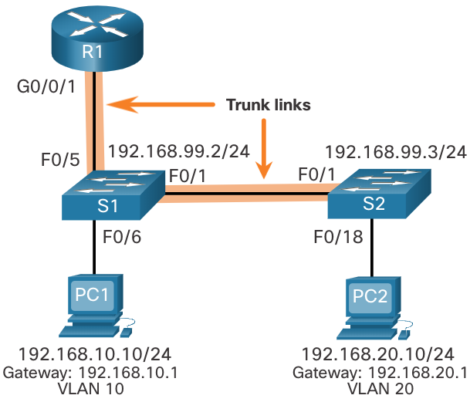
Router-on-a-Stick Inter-VLAN Routing Router-on-a-Stick Scenario
In the figure, the R1 GigabitEthernet 0/0/1 interface is connected to the S1 FastEthernet 0/5 port. The S1 FastEthernet 0/1 port is connected to the S2 FastEthernet 0/1 port. These are trunk links that are required to forward traffic within and between VLANs.
To route between VLANs, the R1 GigabitEthernet 0/0/1 interface is logically divided into three subinterfaces, as shown in the table. The table also shows the three VLANs that will be configured on the switches.
Assume that R1, S1, and S2 have initial basic configurations. Currently, PC1 and PC2 cannot ping each other because they are on separate networks. Only S1 and S2 can ping each other, but they but are unreachable by PC1 or PC2 because they are also on different networks.
To enable devices to ping each other, the switches must be configured with VLANs and trunking, and the router must be configured for inter-VLAN routing.
Subinterface | VLAN | IP Address
G0/0/1.10 | 10 | 192.168.10.1/24
G0/0/1.20 | 20 | 192.168.20.1/24
G0/0/1.30 | 99 | 192.168.99.1/24

Slide 45
Router-on-a-Stick Inter-VLAN Routing R1 Subinterface Configuration
The router-on-a-stick method requires you to create a subinterface for each VLAN to be routed. A subinterface is created using the interface interface_id subinterface_id global configuration mode command. The subinterface syntax is the physical interface followed by a period and a subinterface number. Although not required, it is customary to match the subinterface number with the VLAN number.
Each subinterface is then configured with the following two commands:
encapsulation dot1q vlan_id [native] - This command configures the subinterface to respond to 802.1Q encapsulated traffic from the specified vlan-id. The native keyword option is only appended to set the native VLAN to something other than VLAN 1.
ip address ip-address subnet-mask - This command configures the IPv4 address of the subinterface. This address typically serves as the default gateway for the identified VLAN.
Repeat the process for each VLAN to be routed. Each router subinterface must be assigned an IP address on a unique subnet for routing to occur. When all subinterfaces have been created, enable the physical interface using the no shutdown interface configuration command. If the physical interface is disabled, all subinterfaces are disabled.

Slide 46
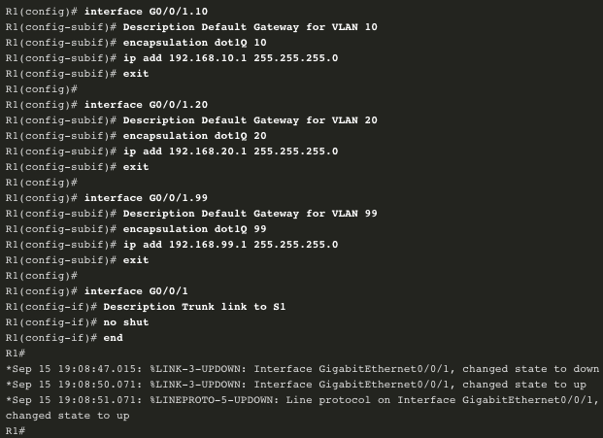
Router-on-a-Stick Inter-VLAN Routing R1 Subinterface Configuration (Cont.)
In the configuration, the R1 G0/0/1 subinterfaces are configured for VLANs 10, 20, and 99.

Slide 47
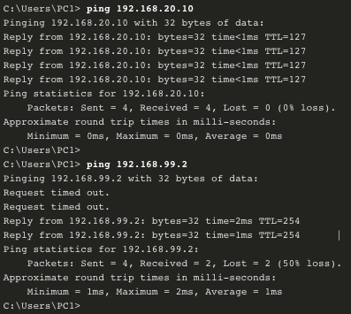
Router-on-a-Stick Inter-VLAN Routing Verify Connectivity Between PC1 and PC2
The router-on-a-stick configuration is complete after the switch trunk and the router subinterfaces have been configured. The configuration can be verified from the hosts, router, and switch.
From a host, verify connectivity to a host in another VLAN using the ping command. It is a good idea to first verify the current host IP configuration using the ipconfig Windows host command.
Next, use ping to verify connectivity with PC2 and S1, as shown in the figure. The ping output successfully confirms inter-VLAN routing is operating.

Slide 48
Router-on-a-Stick Inter-VLAN Routing Router-on-a-Stick Inter-VLAN Routing Verification
In addition to using ping between devices, the following show commands can be used to verify and troubleshoot the router-on-a-stick configuration.
show ip route
show ip interface brief
show interfaces
show interfaces trunk

Slide 49
Inter-VLAN Routing using Layer 3 Switches

Slide 50
Inter-VLAN Routing using Layer 3 Switches Layer 3 Switch Inter-VLAN Routing
Inter-VLAN routing using the router-on-a-stick method is simple to implement for a small to medium-sized organization. However, a large enterprise requires a faster, much more scalable method to provide inter-VLAN routing.
Enterprise campus LANs use Layer 3 switches to provide inter-VLAN routing. Layer 3 switches use hardware-based switching to achieve higher-packet processing rates than routers. Layer 3 switches are also commonly implemented in enterprise distribution layer wiring closets.
Capabilities of a Layer 3 switch include the ability to do the following:
Route from one VLAN to another using multiple switched virtual interfaces (SVIs).
Convert a Layer 2 switchport to a Layer 3 interface (i.e., a routed port). A routed port is similar to a physical interface on a Cisco IOS router.
To provide inter-VLAN routing, Layer 3 switches use SVIs. SVIs are configured using the same interface vlan vlan-id command used to create the management SVI on a Layer 2 switch. A Layer 3 SVI must be created for each of the routable VLANs.

Slide 51
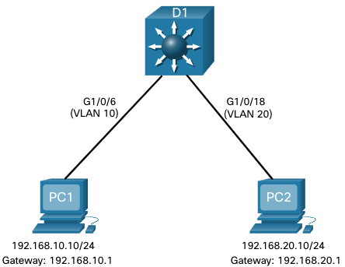
Inter-VLAN Routing using Layer 3 Switches Layer 3 Switch Scenario
In the figure, the Layer 3 switch, D1, is connected to two hosts on different VLANs. PC1 is in VLAN 10 and PC2 is in VLAN 20, as shown. The Layer 3 switch will provide inter-VLAN routing services to the two hosts.

Slide 52
Inter-VLAN Routing using Layer 3 Switches Layer 3 Switch Configuration
Complete the following steps to configure S1 with VLANs and trunking:
Step 1. Create the VLANs. In the example, VLANs 10 and 20 are used.
Step 2. Create the SVI VLAN interfaces. The IP address configured will serve as the default gateway for hosts in the respective VLAN.
Step 3. Configure access ports. Assign the appropriate port to the required VLAN.
Step 4. Enable IP routing. Issue the ip routing global configuration command to allow traffic to be exchanged between VLANs 10 and 20. This command must be configured to enable inter-VAN routing on a Layer 3 switch for IPv4.

Slide 53
Inter-VLAN Routing using Layer 3 Switches Layer 3 Switch Inter-VLAN Routing Verification
Inter-VLAN routing using a Layer 3 switch is simpler to configure than the router-on-a-stick method. After the configuration is complete, the configuration can be verified by testing connectivity between the hosts.
From a host, verify connectivity to a host in another VLAN using the ping command. It is a good idea to first verify the current host IP configuration using the ipconfig Windows host command.
Next, verify connectivity with PC2 using the ping Windows host command. The successful ping output confirms inter-VLAN routing is operating.

Slide 54
Inter-VLAN Routing using Layer 3 Switches Routing on a Layer 3 Switch
If VLANs are to be reachable by other Layer 3 devices, then they must be advertised using static or dynamic routing. To enable routing on a Layer 3 switch, a routed port must be configured.
A routed port is created on a Layer 3 switch by disabling the switchport feature on a Layer 2 port that is connected to another Layer 3 device. Specifically, configuring the no switchport interface configuration command on a Layer 2 port converts it into a Layer 3 interface. Then the interface can be configured with an IPv4 configuration to connect to a router or another Layer 3 switch.

